Slide 1
Autistic Leather
THRIVE 2024

Slide 2
Content Warning
Ableism
Consent Violation
Mental Illness
Self-Harm
Trauma

Slide 3
girl Calyco
MAsT: Everett Secretary/Treasurer
Leather Reign Weekend Fun Coordinator Scholarship Committee Chair
Stone Soup Registration girl
Leather est. 2010
FL → WA
Owned
Polyamorous
Autistic

Slide 4
There are many ways to be autistic.

Slide 5
Autism Spectrum Disorder
“a neurological and developmental disorder that affects how people interact with others, communicate, learn, and behave”
National Institute of Mental Health
Difficulty reading & expressing emotions
Difficulty with sudden change
Honest, direct, and blunt
Takes things literally
Sensory sensitivity
Passionate about interests
Repetitive behaviors and stims

Slide 6
Models of Disability
Medical:
The person is disabled by abnormalities that must be fixed, cured, or masked to fit the environment.
Social:
The person is disabled by the environment, which must be adapted to accommodate the needs of the individual.

Slide 7
Communication
Honesty
Transparency
Directness
Boundaries
Filtering
Negotiation

Slide 8
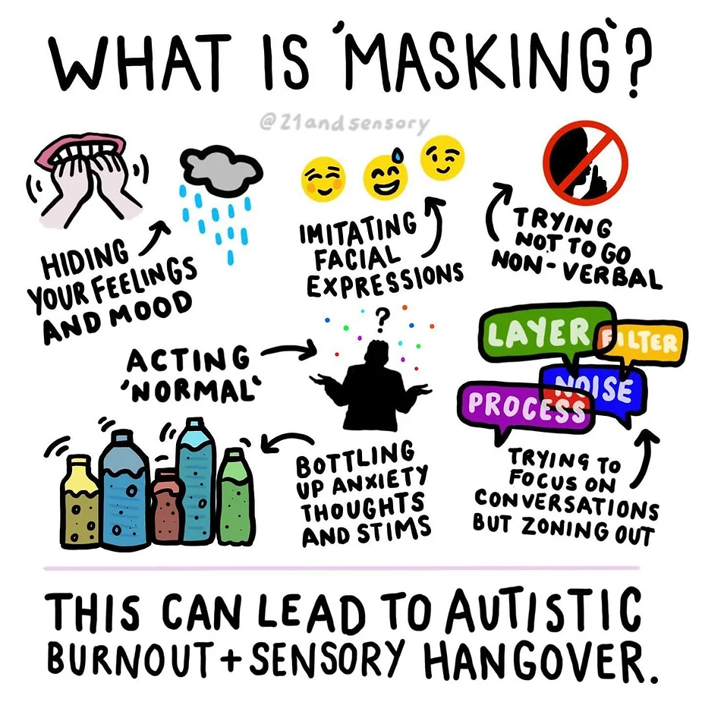

Slide 9
Mental Health
Anxiety
Depression
Executive Dysfunction
Hypervigilance
Loops
Masking
Meltdowns
Overstimulation
Learn your triggers
Have a plan
Listen generously
Be gentle with yourself
Lean into the dynamic
Trust your community

Slide 10
Problem-Solving
Compromise
Stimming
Unmasking
Do-overs
Sensory Accommodation
Gloves
Headphones
Sunglasses
Nonverbal Options
Texting
Passing notes
Signing
Accountability
Lean into the dynamic
Reach out to your community
Daily check-ins
Location sharing
Body doubling
Communication
Say what you mean!
Thesaurus

Slide 11
Planning
Calendars
Schedules
Budgets
…oh my!

Slide 12
Protocols should serve the dynamic.
Let it be weird.

Slide 13
Neurodivergent Love Locutions
Infodumping
Parallel Play
Support Swapping
Deep Pressure
Penguin Pebbling

Slide 14
Sensation
Sights
Sounds
Smells
Tastes
Textures
Thoughts

Slide 15
Kink Reframing
Deep Pressure → Bondage
Thumb-sucking → Littles
Dermatillomania → Piquerism
Overstimulation → Sensory Deprivation and/or Mindfuck
Special Interest → Dollification
Biting → Biting
(in a sexy way)

Slide 16
Munches & Play Parties
Buddy System
Exit Strategy
Earplugs
Aftercare
Virtual
Seek out neurodiversity!
Create your own space!

Slide 17
Acknowledgements
Master Devyn Stone
Drummer Pony
Master Penguin & slave ginna
Raven Kaldera & Joshua Tenpenny
My Daddy, Treyson

Slide 18
Resources
autisticadvocacy.org
awnnetwork.org
stimpunks.org
FOLLOW AUTISTIC PRESENTERS!
Devyn Stone
Drummer Pony
Gloria Jackson-Nefertiti
HannahTheScribe
Kade
Lord Allen
Mx Pucks A’Plenty

Slide 19
girl Calyco
waffletaxi@gmail.com
Fetlife: @Calyco
Facebook: /waffletaxi
Instagram: @waffletaxi
Cashapp: $waffletaxi
Venmo: @waffletaxi
Autistic Leather

